Slide 1
RE-MIND.ca
Travis Robertson
BCCSA Regional Safety Advisor
trobertson@bccsa.ca
604-760-5195

Slide 2
Travis Robertson
trobertson@bccsa.ca
Notes:
Our conversation is about resources to start the conversation.
Launched Sep 2021
Made with the construction industry and Diana Vissers - Mental Health and Disability Management Expert.

Slide 4
RE-MIND.ca
Travis Robertson
trobertson@bccsa.ca

Slide 5
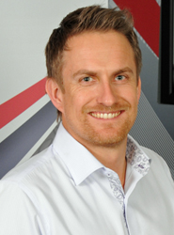
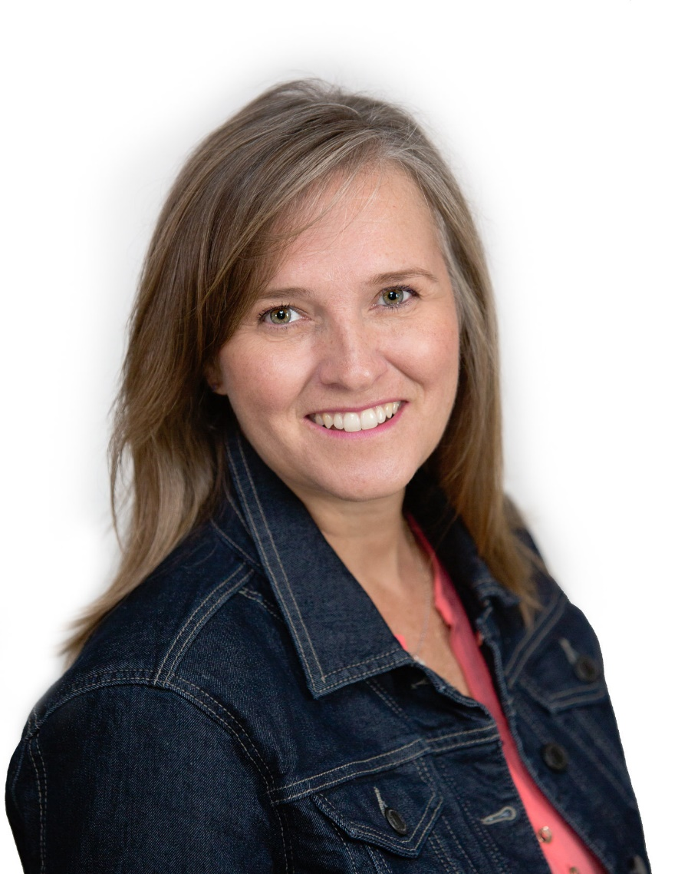
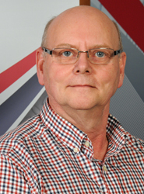
Travis Robertson
trobertson@bccsa.ca
Tanya Steele
tsteele@bccsa.ca
Art Reynolds
areynolds@bccsa.ca

Slide 6
Thank you
Travis Robertson
Regional Safety Advisor

